Slide 1
UNIT - 13
BUSINESS CYCLES

Slide 2
Business Cycle:
The term business cycle refers to a wave like fluctuation in the overall level of economic activity particularly in national output, income, employment, and prices that occur in a more or less regular time sequence.
It is nothing but rhythmic fluctuation in the segregate level of a economic activity of a nation.

Slide 3
Causes of Business Cycle:
Climatic conditions.
Psychological factors.
Due to innovation carried out in industries.
Due to non monetary factors (war, earthquakes, strikes etc.).
Due to under or over consumption.
Due to investment.
Due to excess of investment over savings, etc.

Slide 4
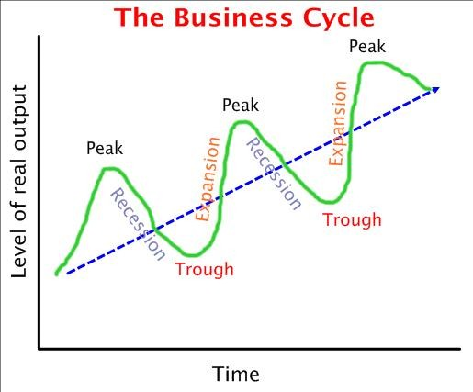
Steady growth line
Or
Full employment line

Slide 5
Phases of Business Cycle:
Prosperity
A high level of output, income, employment & trade.
A high level of purchasing power, consumption expenditure & demand.
expansion in bank credit.
Share market gives handsome gains.
A state of enthusiasm exist in business community.
Industrial & economic activities show remarkable expansion.
Boom
Prices, wages, interest, incomes, profits moves in upward direction.
Business people borrow more and invest.
There is higher output, income and employment.
Higher purchasing power & level of effective demand reaches to new heights.
It is a symptom of end of prosperity phase and beginning of recession.

Slide 6
Phases of Business Cycle:
Recession
It is a period of time where in the aggregate level of economic activity starts declining. There is contraction and slowing down of business activity.
Output, income, employment & trade starts declining.
Purchasing power, consumption expenditure & demand starts declining.
Depression
Reduction in volume of output, trade and other transactions.
Increase in the level of unemployment.
Reduction in aggregate income.
Reduction in prices and fall in interest rate.
Decline in consumption expenditure & fall in the level of demand.
Reduction in the investment.

Slide 7
Recovery
Increase in government expenditure.
Changes in production techniques.
Diversification in investment in new regions.
Exploration of new sources of energy.
New innovations.

Slide 8
Theories of Business Cycle:
Schumpeter’s innovations theory of Business Cycles
Over investment theory of Von Hayek
Hawtrey’s Pure Monetary Theory of Trade Cycle
Modern Theory: Interaction of Multiplier & accelerator principle

Slide 9
Measures to control Business Cycle:
Monetary measures:
Monetary policy
Fiscal policy
Physical control

